Slide 1

Make A-way
Making way to better living atmospheres
ROHIT DHARMADHIKARI
GAURAV BOTHRA
MEHUL KUMAR UTTAMCHAND

Slide 2
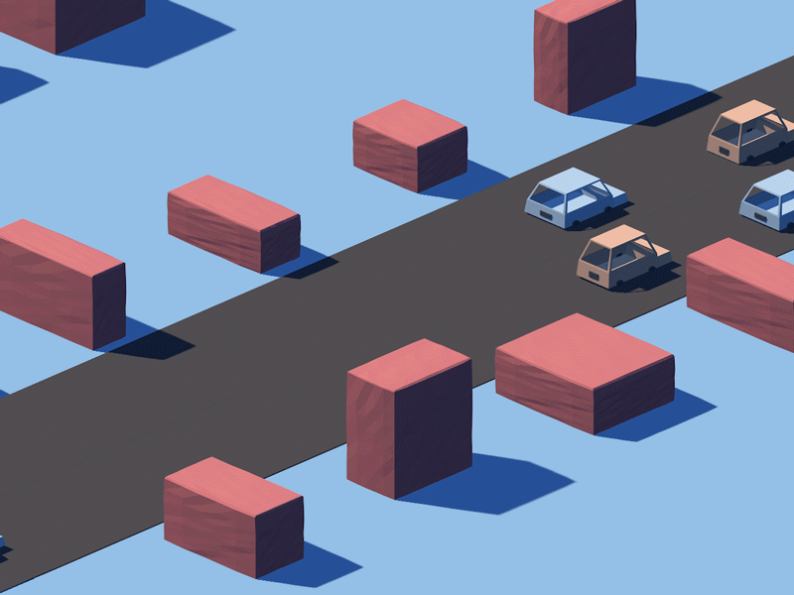
Agenda
Problem Scenario
Solution Description
Algorithm
Implementation
Future Scope

Slide 3

Problem Scenario
Loss of Productivity and Increased Frustration
In Major cities in Europe, people spend more than 130 hours a year in traffic congestion
https://www-statista-com.ezproxy.univ-catholille.fr/statistics/1112832/cities-hours-lost-traffic-jams-europe/ --link to chart
Pollution and congestion in urban areas

Slide 4
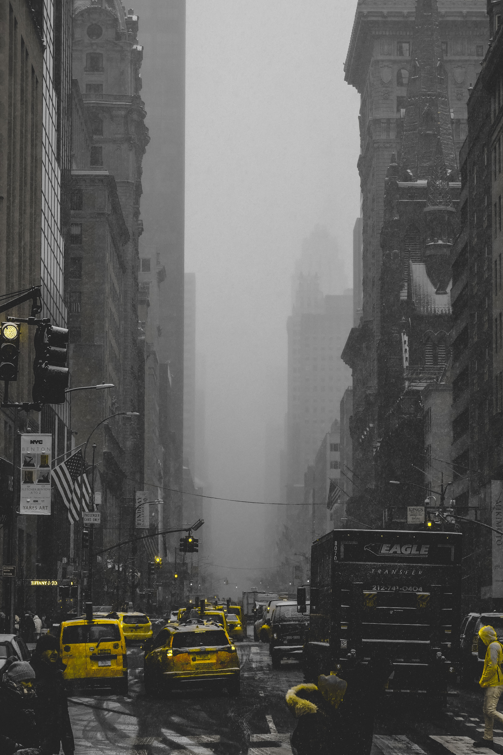
FOSSIL FUEL CONSUMPTION
Problem Scenario
Number of new passenger vehicles by type, Germany
^{2.5 million}
^{2 million}
Petrol
^{1.5 million}
Diesel
^{1 million}
^{500,000}
Full hybrid
Electric vehicles
⁰
Plug-in hybrid
2001
2004
2006
2008
2010
2012
2014
2016
2019
90% of cars sold in 2019 are still powered by Petrol and Diesel
Source: International Council on Clean Transport (ICCT) and European Environment Agency
OurWorldInData.org/transport • CC BY

Slide 5
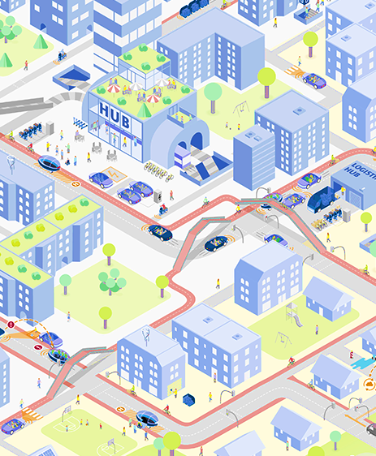
Make A-WAY
Solution Description
MAKING WAY TO BETTER LIVING ATMOSPHERES
Reducing traffic congestion
Improving air quality
WHAT
Dynamic control over Traffic Signals
By reducing waiting time at signals
Implement system in simulations and later in Real-world
HOW
Residential areas with air and noise pollution
LEZs with high congestion
WHERE

Slide 6
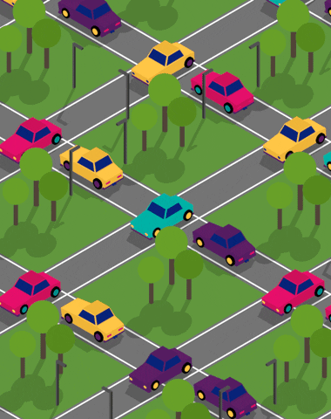
What are Low emission zones
Solution Description
Urban zones that only allow the least polluting vehicles
Drivers are fined for not respecting the restrictions
Promote use of Soft Mobility (E-bikes and E-scooters)
In one year of setting up LEZ in brussels, city experienced 11% reduction in NOx and 11.5% reduction of PM2.5
LEZ curb pollution but haven’t proven to be effective in curbing congestion.
https://eurocities.eu/latest/low-emission-zones-challenges-and-solutions/
Pollution and congestion in urban areas: The effects of low emission zones

Slide 7

EVOLUTIONARY ALGORITHMs
Algorithm
Based on Darwin’s theory of evolution.
Genetic Algorithm(GA) is an evolutionary algorithm used to generate high quality solution for optimization and search problems.
Genetic algorithm is inspired by the concept of natural selection which was first mentioned in Darwin’s book “The origin of species”
This algorithm incorporates biologically inspired operators such as mutation, crossover and survival of the fittest.
“All species of organisms arise and develop through the natural selection of small, inherited variations that increase the individual's ability to compete, survive, and reproduce” --Darwin

Slide 8
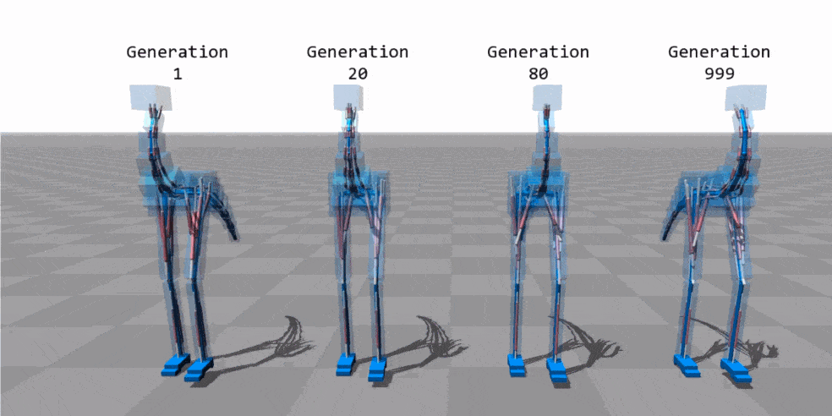
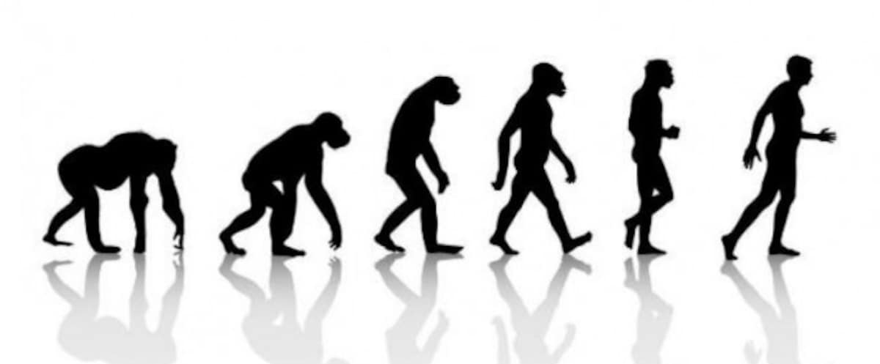
What is happening inside GA
ALgorithm
Populate
Compete
Select
Mate
Mutate

Slide 9





applying ga on traffic lights
Implemnntation
Fitness Function
Chromosome
Phase
Time
Phase
Time
Phase
Time
10
10
10
3
3
3
20
20
20
Junction1
Junction2
Junction3
Co2 Emissions
Waiting time
Fitness function is based on the waiting time for each car and total CO2 emissions as optimization variables
A Chromosome is a dictionary of the Phase-Time clock of all Traffic lights at multiple junctions which are our control variables
9

Slide 10
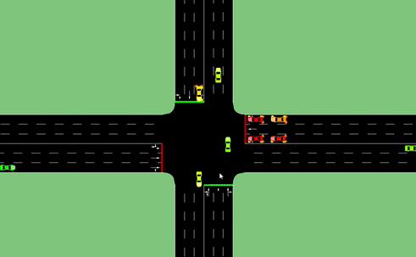
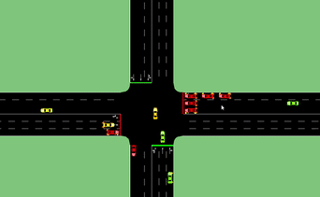
What did “the model” learn and what did we learn?
Implementation
Generation 24
Iteration 15
Generation 14
Iteration 15
After epoch 14, the model realized that keeping all signals red leads to a traffic jam

Slide 11

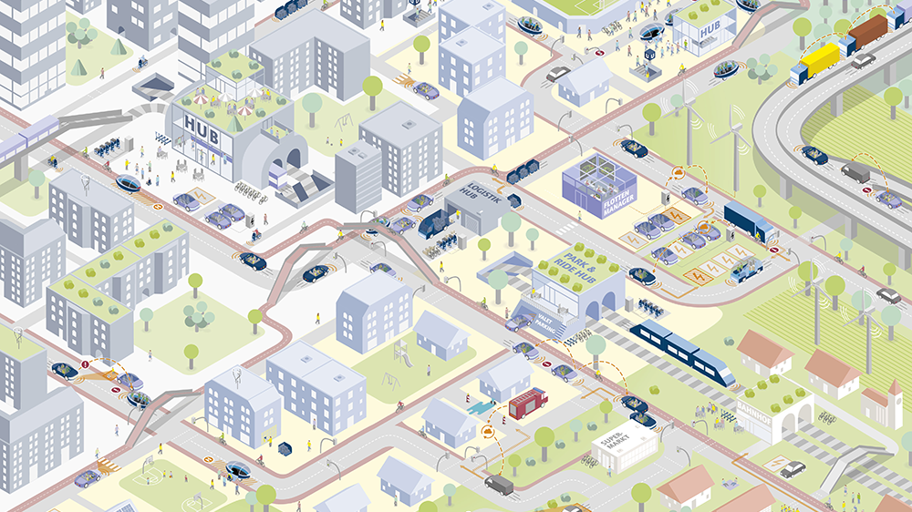

What is the way to make a-way?
Future scope
Current Scenario
Make a-way
Framework that can manage multiple traffic lanes
Accept information from multiple lanes and junctions
Change signals simultaneously at multiple junctions
Future Vision
Complete training algorithm on a variety of complex real-world scenarios
Accept more variables and perform more interactions with cars (Request to change lane, etc.)
Build a simulation for an LEZ and train algorithm to solve the scenario.
LEZ Representation

Slide 12
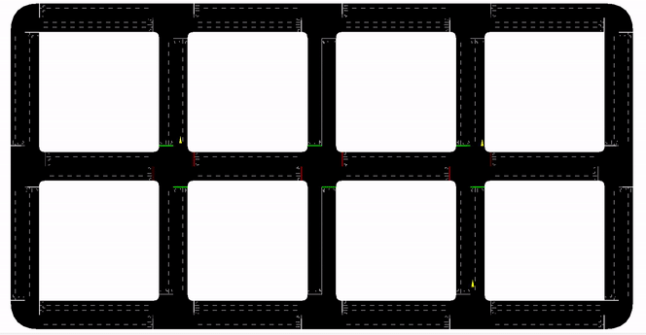
Appendix
Trained Modeled of the 5 generation with 3-6 laned Junctions

Slide 13
References
1. GitHub - geronimocharlie/SumoRinger: IP Traffic Simulation: Using Genetic Algorithms on Open Street Map data to decrease emissions and optimize traffic flow. Customized on the city of Osnabrueck.
2. TraCI - SUMO Documentation (dlr.de)

Slide 14
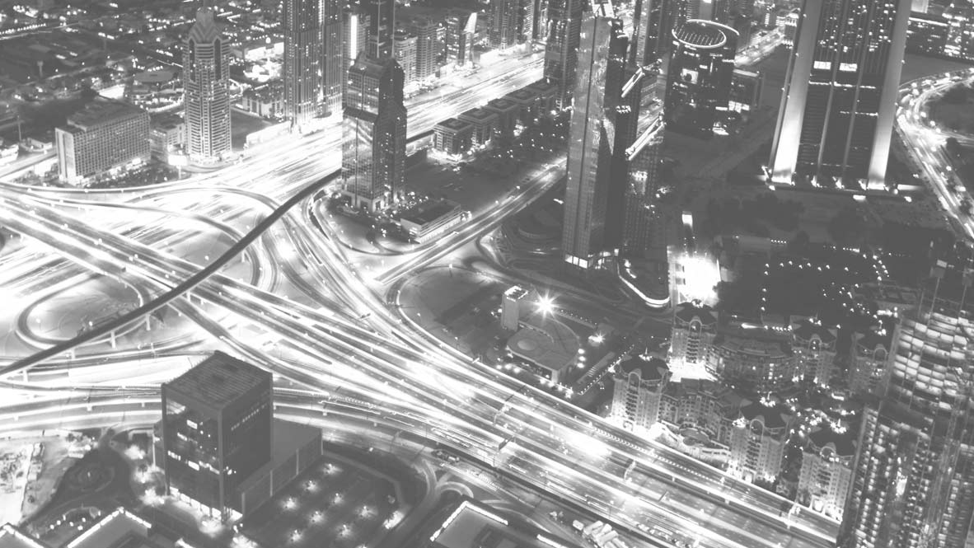
Thank you

